Slide 1

Wand Man
By MagiDev

Slide 2
Team MagiDev
Bar Ben-zvi – Design Director
Eli Miller – Technical Director
Hunter Starr –Art Director
Nelson Athow - Producer

Slide 3
New Scripts, Mechanics & Features
Random Generation of Rooms
New Player Spells
Ice Spear Spell
Seeking Arrow Spell
New Firing Patterns & Mechanics
Ring Shot Pattern
Spread Shot Pattern
Burst Mechanic
Boss Script
Handles Boss Attack Patterns & Animations
5. Added Main Menu
6. Added Tutorial
7. Added Death Menu
8. Fixes to Existing Features
1. Fixed Exploding Bullet
2. Improved Spell Switching
9. Added Music Manager
10. Implemented Sound Effects
11. Added Animation Handlers

Slide 4
New Audio Assets
Added Sound Effects For Player Spells
Magic Missile Sound Effect
Bubble Trap Sound Effect
Exploding Bullet Sound Effects
Exploding Bullet Launch
Exploding Bullet Impact
Ice Spear Sound Effect
Seeking Arrow Sound Effect
Added Enemy Sound Effects
Enemy Hurt Sound
Enemy Hurt Sound Low Pitch
Skeleton Death Sound

Slide 5
Sound Effect Showcase

Slide 6
New Art Assets
Added Giant Skeleton Animations
Big Blast Animation
Bone Throw Animation
Stomp Animation
Enemy Animations
Golem Walk
Necromancer Attack & Walk
Skeleton Walk
Zombie Walk
Seeking Spell Animation
Wand Man Walk Animations
Added Tile Textures
Wooden Library Floor Tike
Crate Tile
Skull Tile
Gravestone Tile
Added Seeking Arrow Texture
Added Spell Scroll Texture
Added Big Burger Texture
Added Bone Texture
Added Pile Of Bones Texture
Added Target Texture

Slide 7
Art Showcase

Slide 8

Area 1 “The Underground Cemetery.”

Slide 9


Area 2 “The Living Library”
The Living Library is a place of knowledge and Magic.
The Aural theme of The Living Library is relaxed, chill, and melodic.
The Aural theme of the boss fight is tense, and much faster than the theme of the Main level.

Slide 10
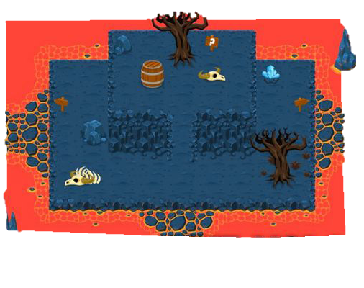

Area 3 “The Volcanic Wasteland”
The Volcanic Wasteland is mysterious and extremely hot.
The Aural theme of The Volcanic Wasteland is slow and ominous, with dissonant notes lending tension to the atmosphere.
The Aural theme of the boss fight music is fast, dramatic, and made frantic by constant involvement of all layers of melody and percussion.

Slide 11
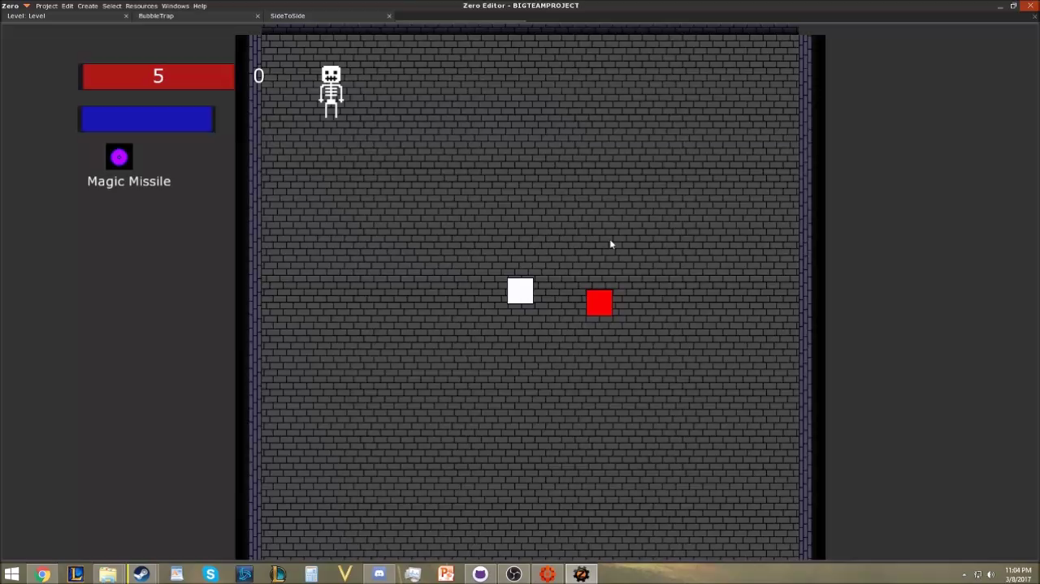
Design Prototype / Core System Development

Slide 12
Game State Summary
Engine Proof Goals
Goals met
Room system
Player movement
Multiple spell types & spell switching
Multiple bullet movement patterns
Basic enemy shooting
Basic enemy movement/AI
Health
Player fade ability
Basic UI
Room system
Player movement
Multiple spell types & spell switching
Basic enemy shooting
Health
Basic enemy movement/AI
Player fade ability
Basic UI
Limited quantity of Art assets

